Slide 1
IMFED: Intelligent model for Emotion Detection from text using BERT
Presented by
Vidisha Arvind
(E23MTCG0004)
Kartikey Saini (E23MTCG0127)
Submitted
To
Arun Kumar
(Assistant Professor)
DEPARTMENT OF COMPUTER SCIENCE ENGINEERING & TECHNOLOGY
BENNETT UNIVERSITY, GREATER NOIDA, 201310, UTTAR PRADESH, INDIA

Slide 2
OUTLINE
Introduction
Project Statement
Model Architecture
Experiment and Implementation
Results Analysis and Validation
Conclusion and Future Work
References

Slide 3
Introduction
In today's digital age, natural language processing (NLP) techniques have gained significant traction in understanding human emotions from textual data.
Emotion recognition from text plays a vital role in various applications such as sentiment analysis, customer feedback analysis, mental health assessment, and more.
With the advent of advanced deep learning models like BERT (Bidirectional Encoder Representations from Transformers), it has become feasible to develop sophisticated models for emotion recognition with high accuracy.

Slide 4
Project Statement
Comparing emotion identification datasets with sophisticated deep learning models.
Choosing BERT over LSTM owing to its contextual awareness, which outperforms static embeddings such as Word2Vec and GloVe.
BERT's bidirectional context processing permits complex word meaning distinctions, which are critical for correct emotion identification.
BERT's advantage in capturing complicated language semantics for emotion analysis is demonstrated over a wide range of real-world datasets.

Slide 5
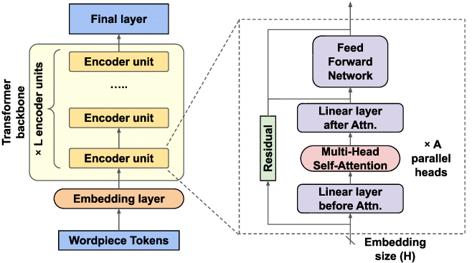
Model Architecture
In BERT emotion detection, the embedding layer turns input tokens (words or sub words) into dense vector representations that capture semantic meaning relevant to the emotions being identified.
Stacked encoder layers process embeddings using multi-head self-attention and feed-forward neural networks. This enables the model to examine the links and dependencies between words, capturing subtle emotional context inside phrases.

Slide 6
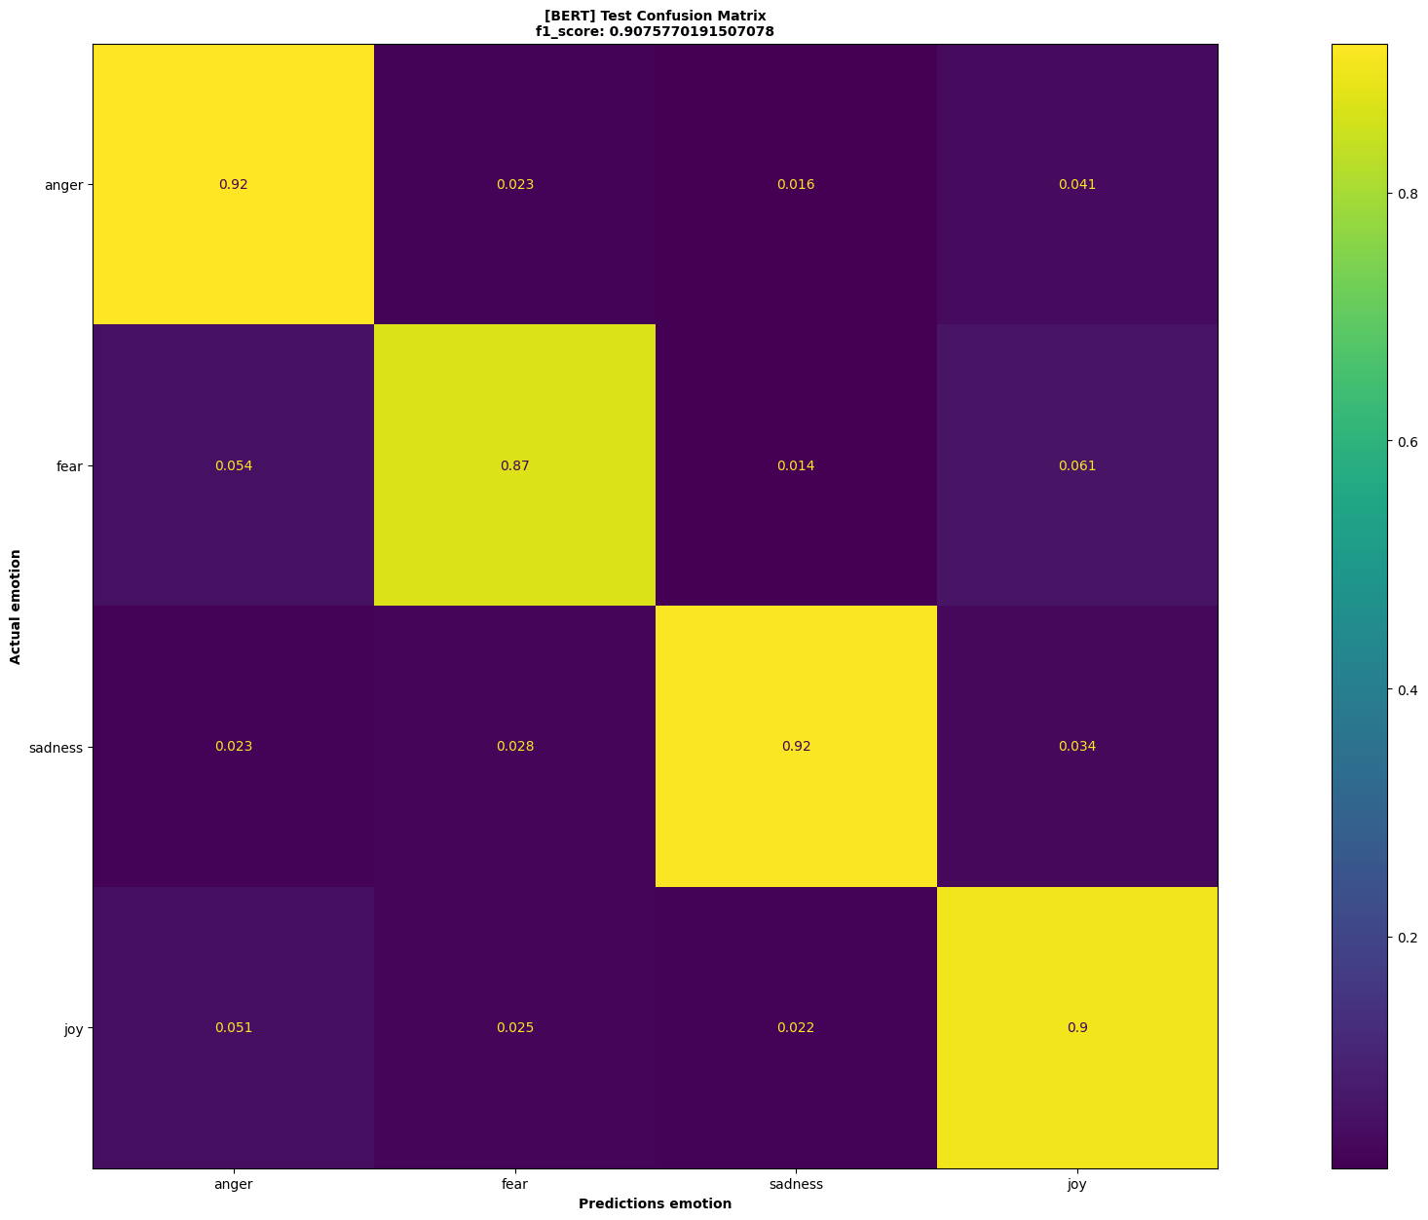
Experiment & Implementation - Go Emotions

Slide 7
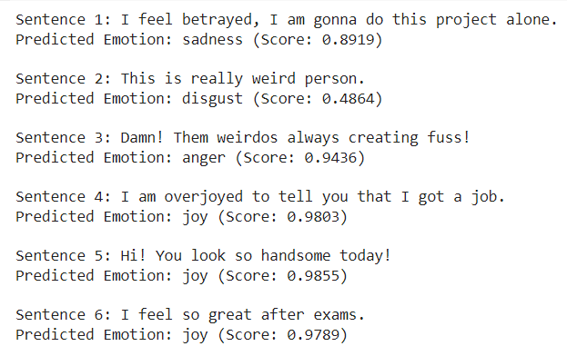
Experiment & Implementation - MELD
Prediction on user sentences:

Slide 8
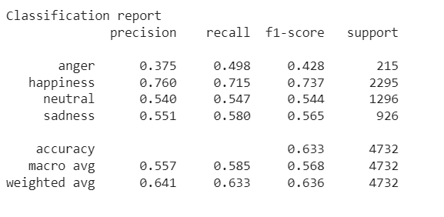
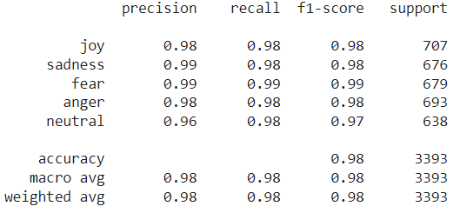
Experiment & Implementation – ISEAR & Tweets
ISEAR
Tweets

Slide 9
Results Analysis & Validation
Dataset | Model(s) | Emotions | Accuracy (%)
MELD | RoBERTa, ALBERT, BERT, DistilBERT | Neutral, Surprise, Fear, Sadness, Joy, Disgust, Anger | RoBERTa: 62.1, ALBERT: 54.6, BERT: 61.7, DistilBERT: 60.6
GoEmotion | RoBERTa , BERT | Anger, Sadness, Fear, Joy | RoBERTa :47.4 , BERT: 61
ISEAR | BERT | Joy, Sadness, Fear, Anger, Neutral | 98
Tweet | BERT + DistilBERT + RoBERTa | Anger, Happiness, Neutral, Sadness | 63.6

Slide 10
Conclusion & Future work
Multimodal Emotion Detection: Our research integrates text and image data to achieve advanced emotion detection. By analyzing verbal and non-verbal cues, our AI system gains a deeper understanding of emotional contexts, enhancing interpretation accuracy.
AI Assistant Integration: These advancements will be incorporated into AI assistants, enabling them to interpret human emotions effectively. This work represents a significant step toward creating empathetic and context-aware AI systems.

Slide 11

Thank You

